Slide 1
Logistics Optimization for Delivery Routes – Amazon
Name : JUNEDUDDIN

Slide 2
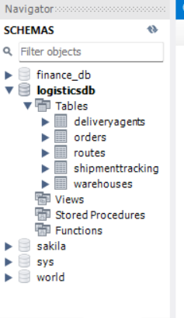
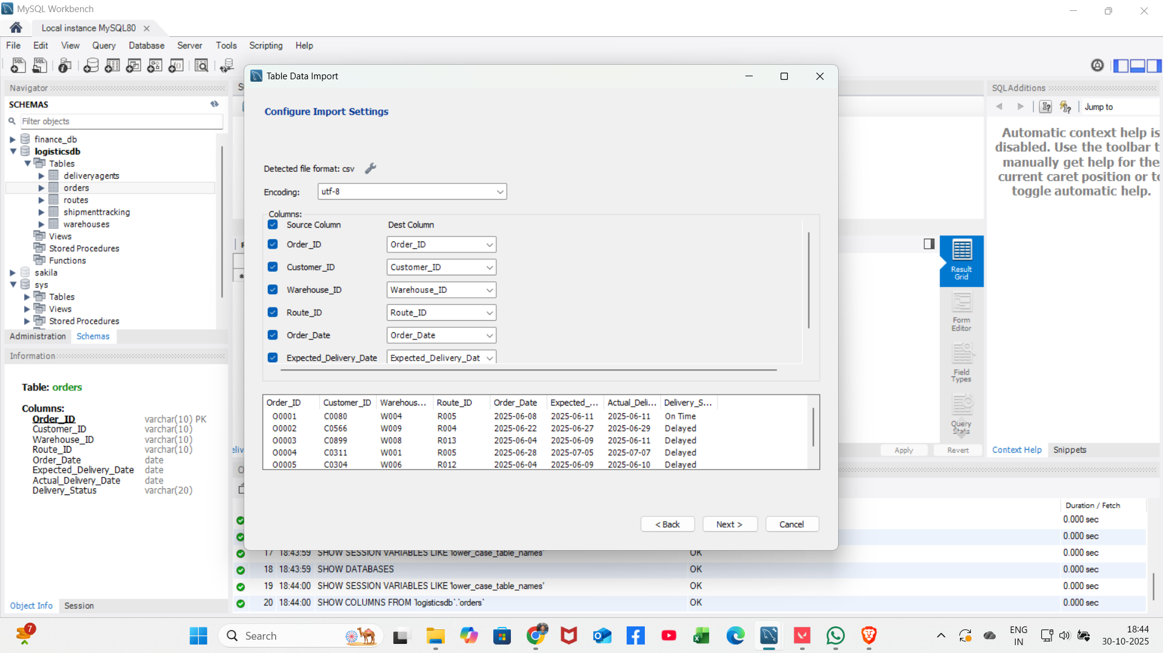
Creation of Tables : Queries
For ShipmentTracking:
CREATE TABLE ShipmentTracking ( Shipment_ID VARCHAR(10) PRIMARY KEY, Order_ID VARCHAR(10), Checkpoint VARCHAR(50), Checkpoint_Time DATE, Delay_Reason VARCHAR(100));
For Orders:
CREATE TABLE Orders ( Order_ID VARCHAR(10) PRIMARY KEY, Customer_ID VARCHAR(10), Warehouse_ID VARCHAR(10), Route_ID VARCHAR(10), Order_Date DATE, Expected_Delivery_Date DATE, Actual_Delivery_Date DATE, Delivery_Status VARCHAR(20));
For Routes:
CREATE TABLE Routes (
Route_ID VARCHAR(10)
PRIMARY KEY, Start_Location VARCHAR(100), End_Location VARCHAR(100), Distance_KM FLOAT, Average_Travel_Time_Min INT, Traffic_Delay_Min INT);
For Warehouses:
CREATE TABLE Warehouses ( Warehouse_ID VARCHAR(10) PRIMARY KEY, Location VARCHAR(100), Processing_Time_Min INT, Dispatch_Time TIME);
Data importing in Respective Tables:
For DeliveryAgents:
CREATE TABLE DeliveryAgents (
Agent_ID VARCHAR(10) PRIMARY KEY, Route_ID VARCHAR(10), Shift_Hours INT, Avg_Speed_KM_HR INT, On_Time_Percentage FLOAT)

Slide 3
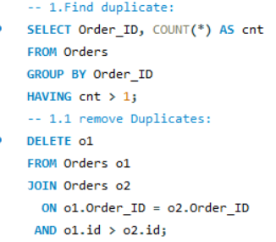
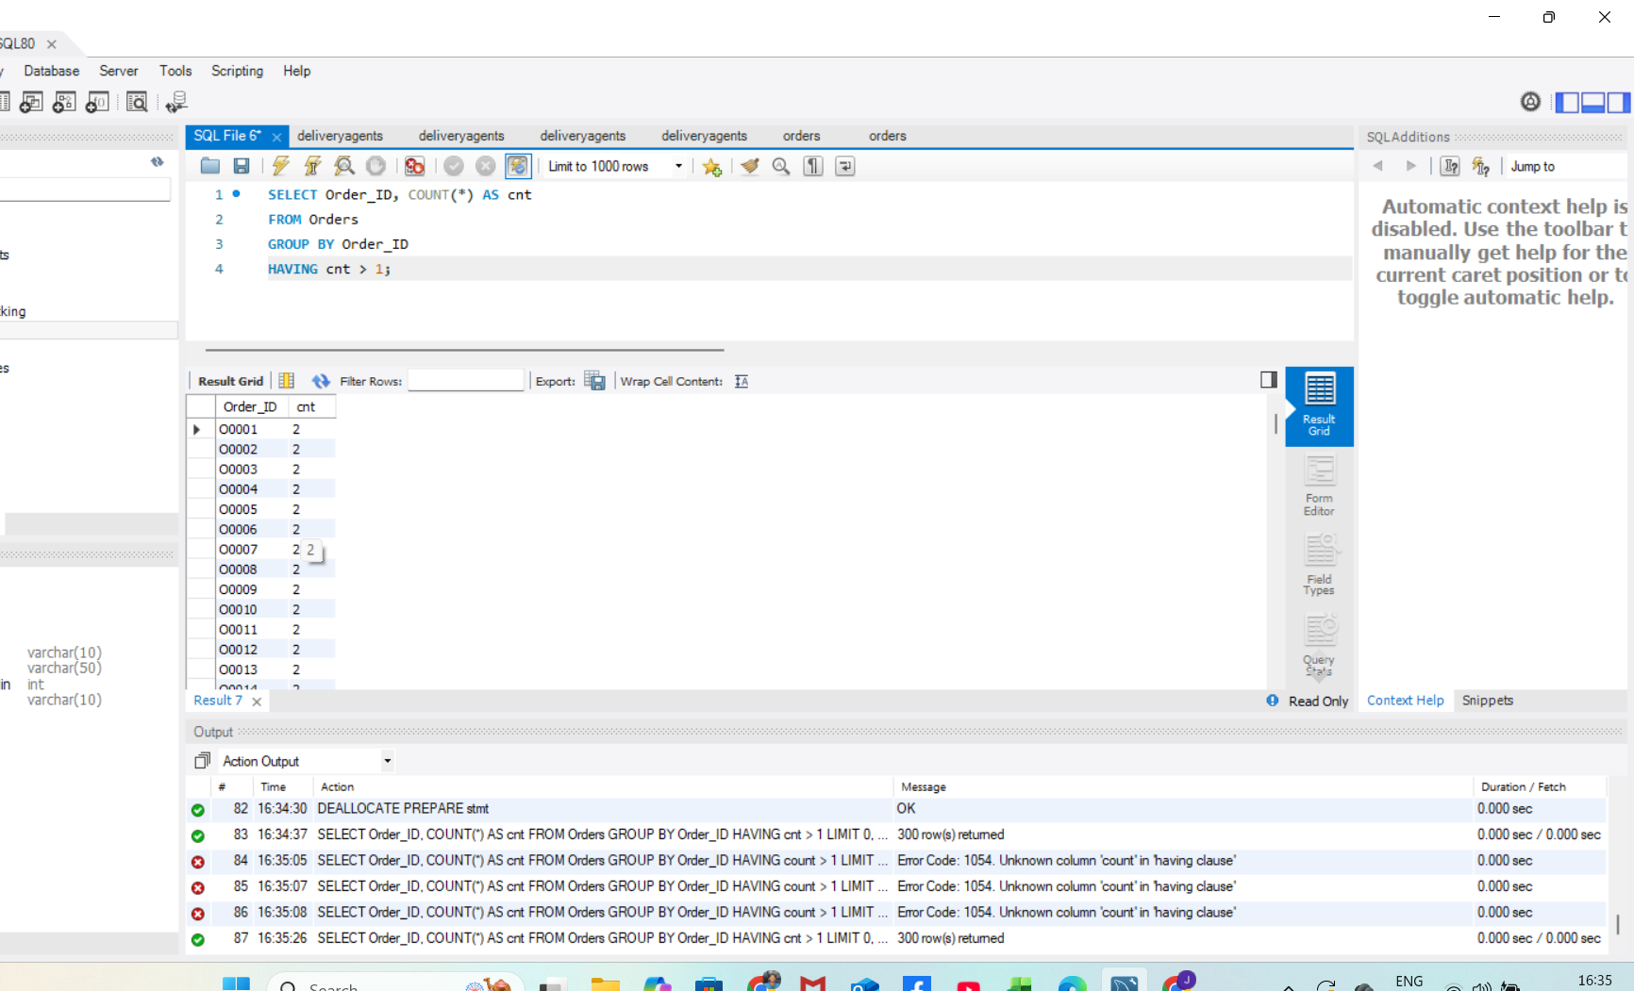
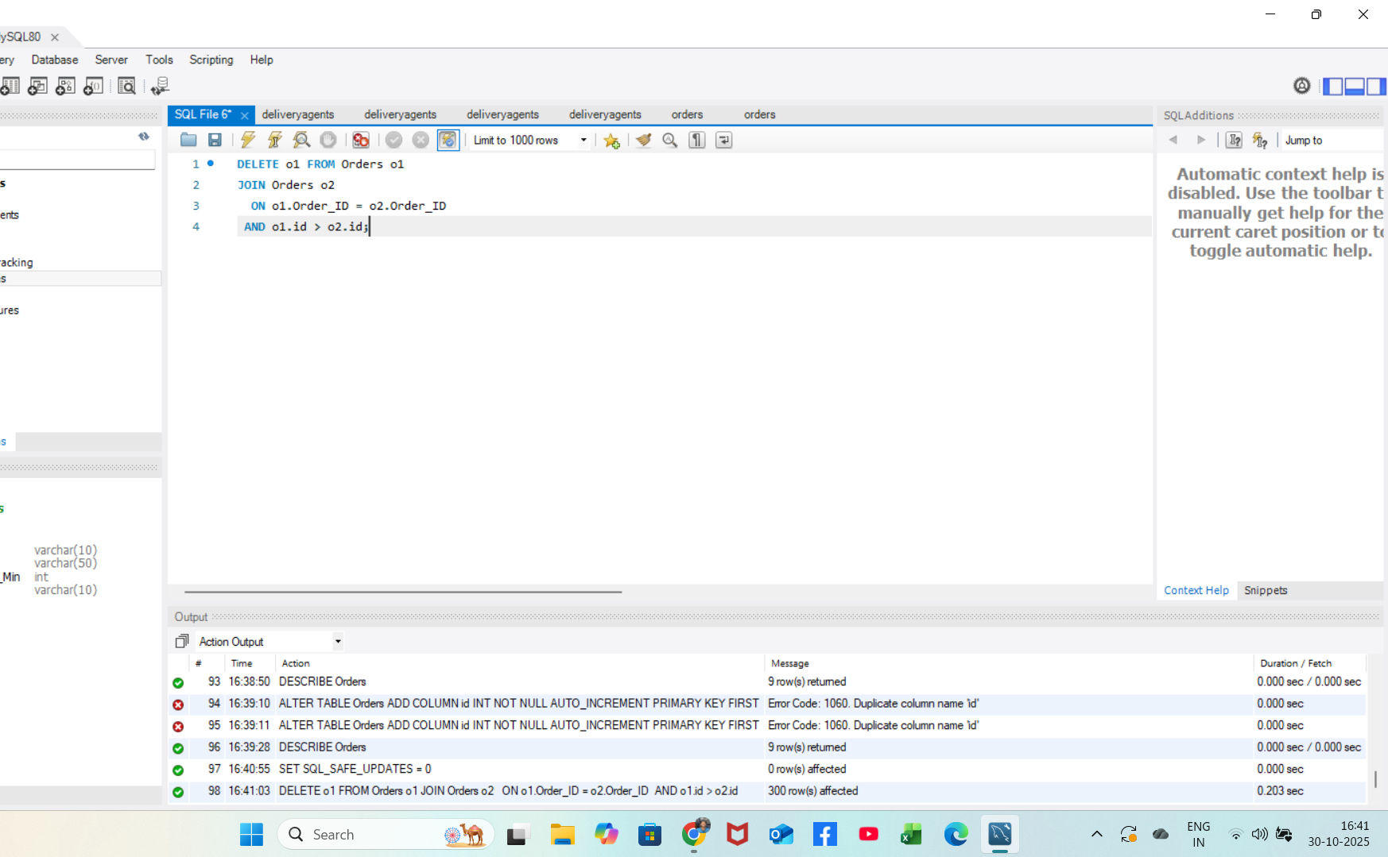
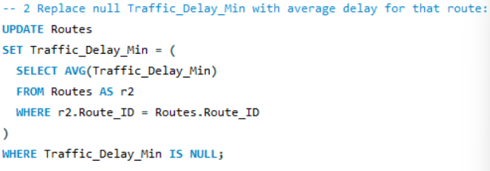
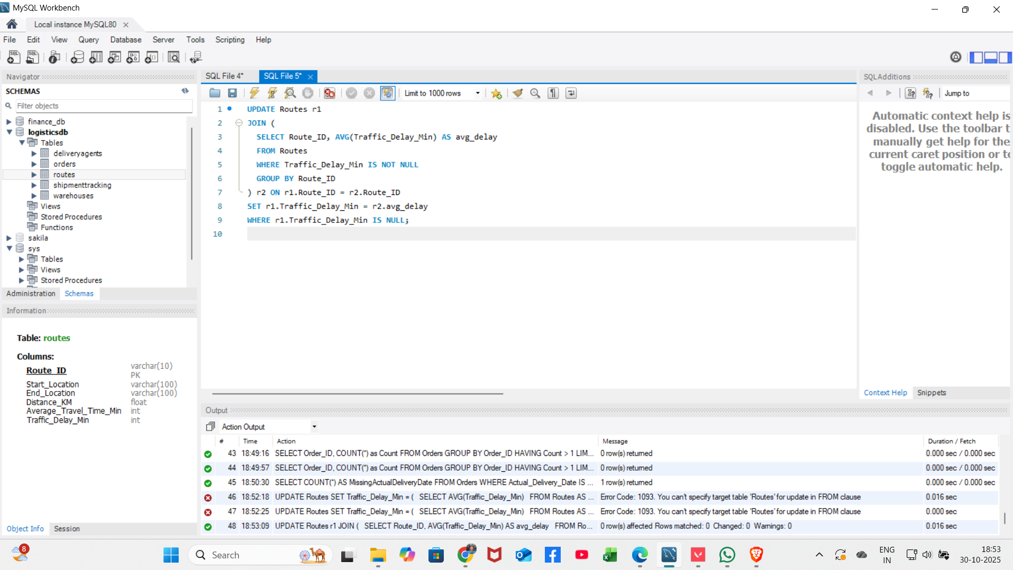
Task 1: Data Cleaning & Preparation
Insights / How is this task performed:
Identify and delete duplicate Order_ID records
Replace NULL Traffic_Delay_Min with route average

Slide 4
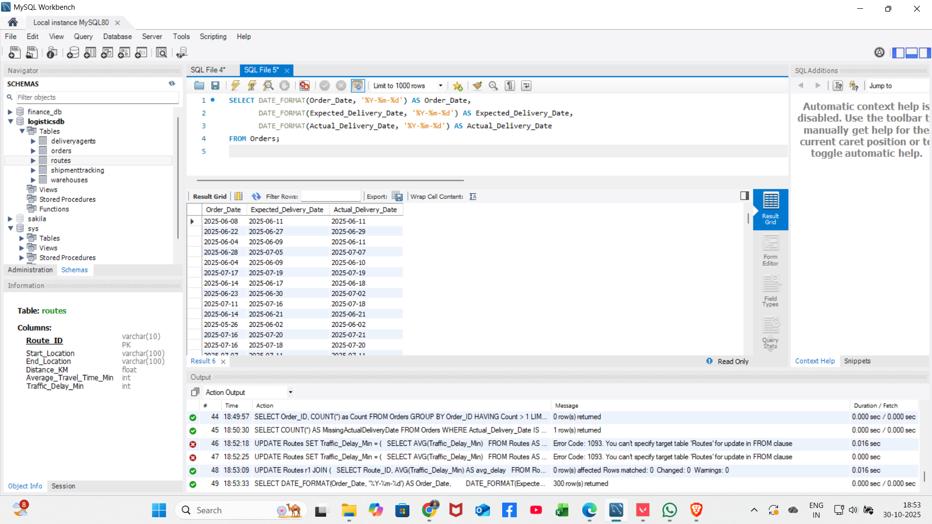
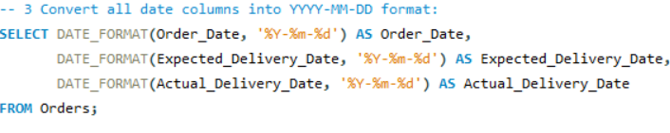
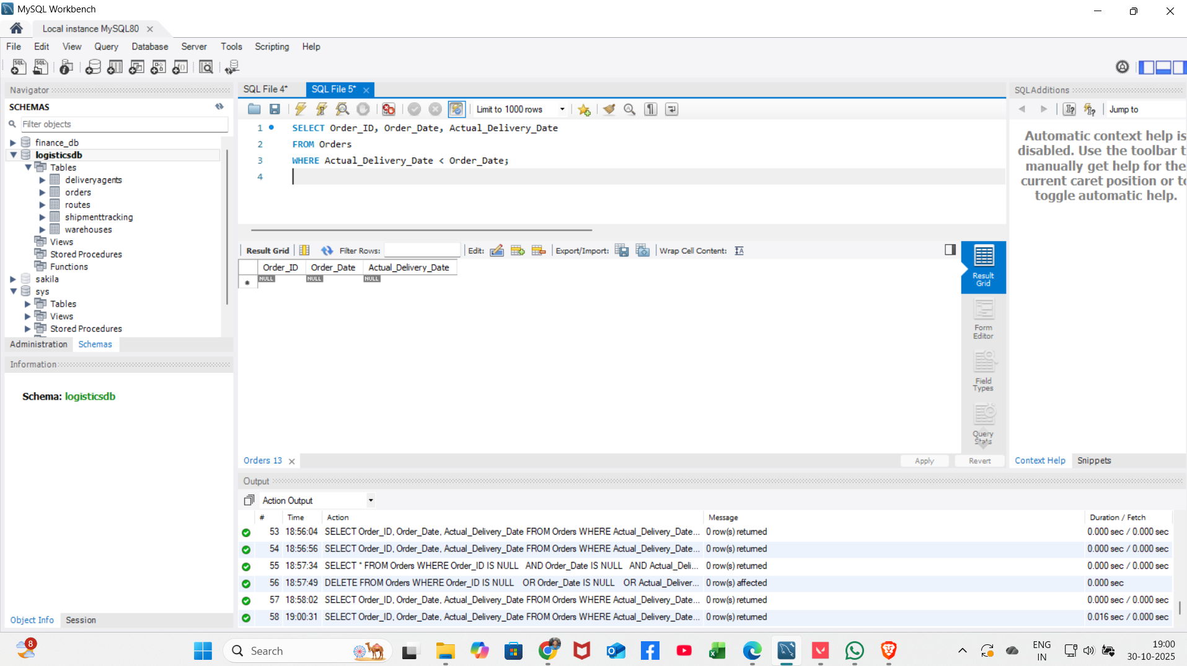
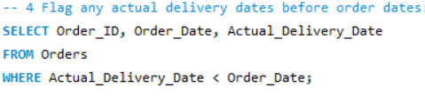
3. Convert all date columns to YYYY-MM-DD format
4. Ensure Actual_Delivery_Date is not before Order_Date

Slide 5
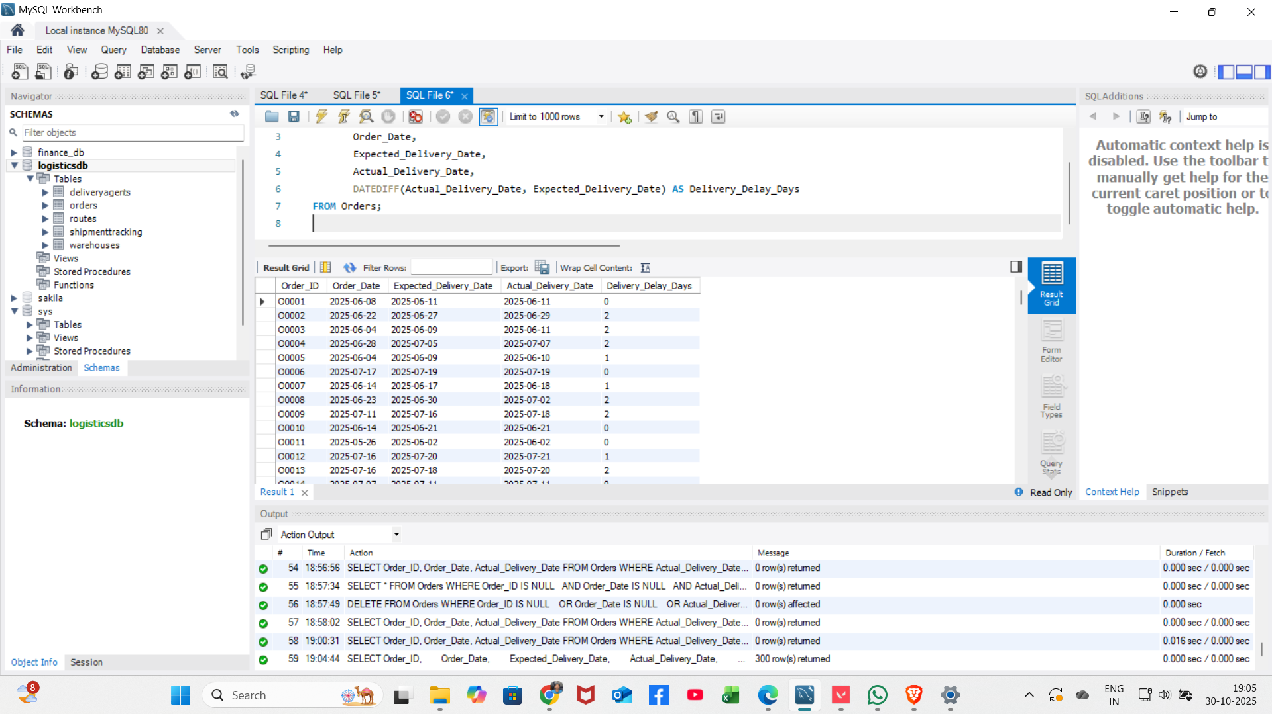
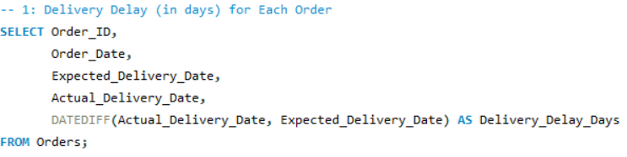
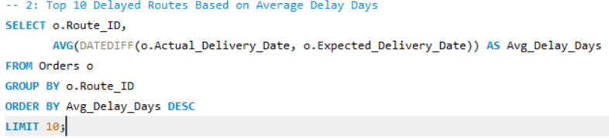
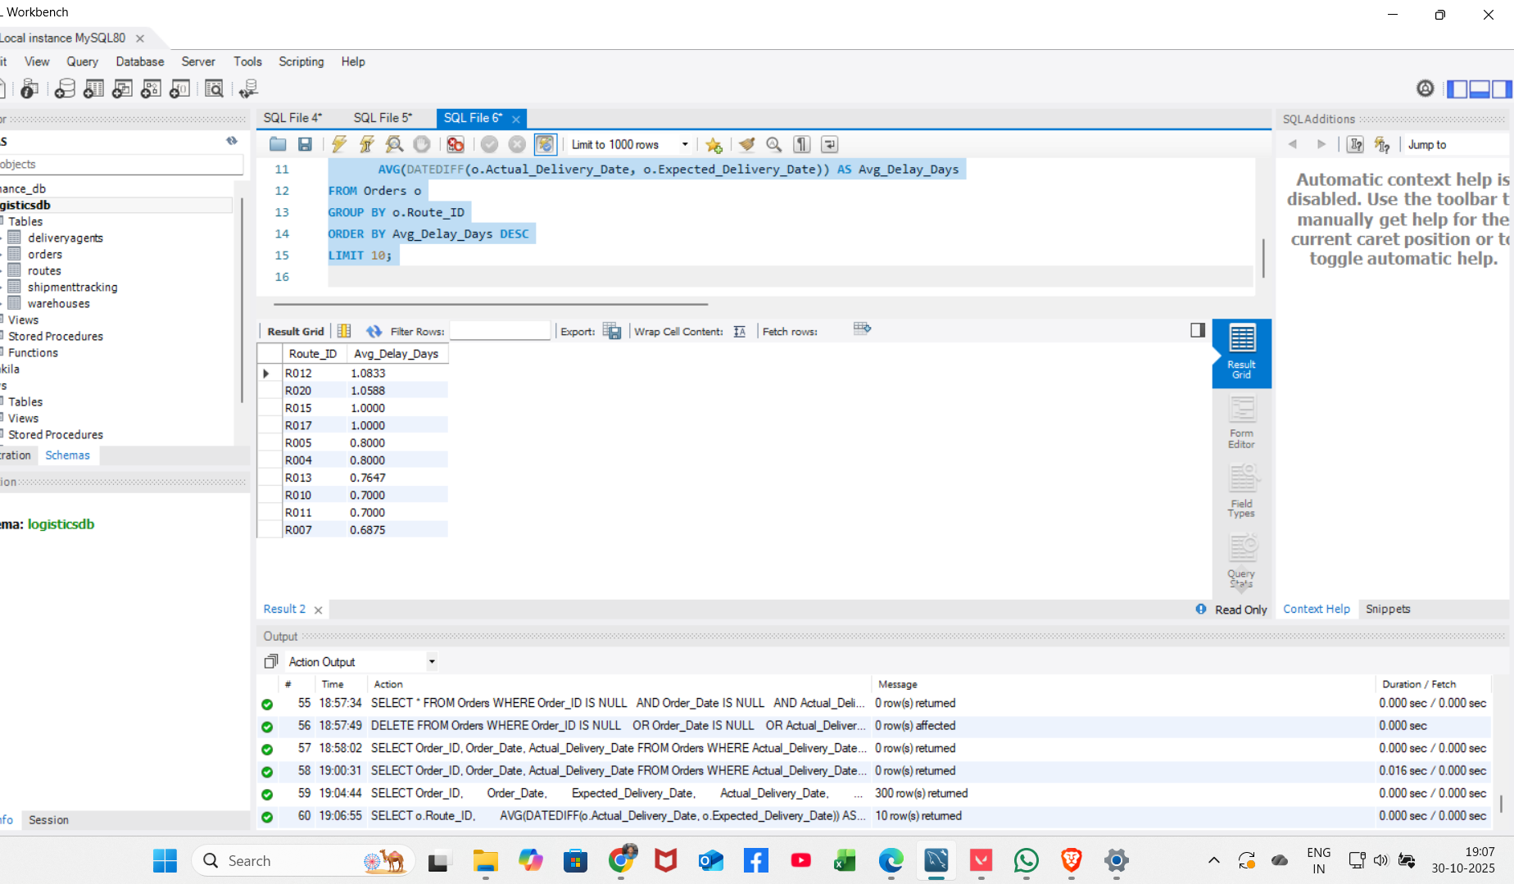
Task 2: Delivery Delay Analysis
Insights / How is this task performed:
1. Calculate delivery delay (in days) for each order
2. Find top 10 delayed routes by average delay

Slide 6
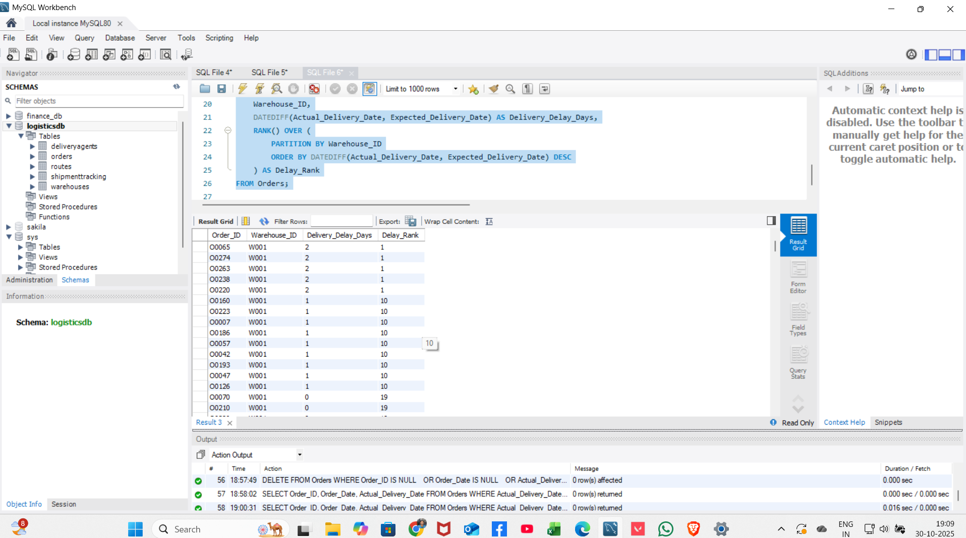
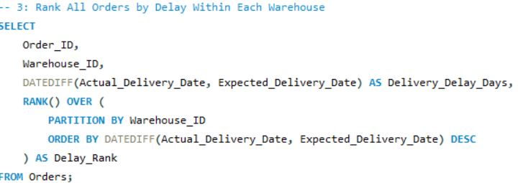
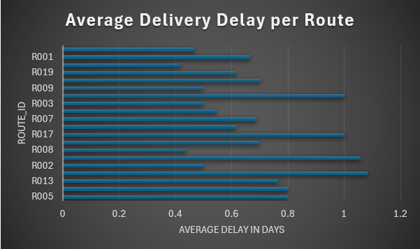
3. Rank orders by delay within each warehouse
Insights:
Some routes (R003, R017, R002, R013) have much higher delivery delays, close to or above 1 day, compared to others.​
Most other routes have moderate delays (0.4 to 0.8 days), but still need monitoring for efficiency.​
Recommendations:
Focus on improving the top delayed routes (R003, R017, R002, R013) to bring down delays check for traffic, warehouse, or process issues.​
Monitor moderate routes regularly so minor delays do not increase.​
Use route performance data to find and fix delivery bottlenecks, keeping overall service reliable.

Slide 7
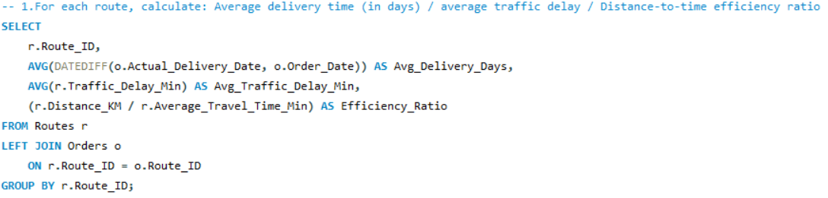
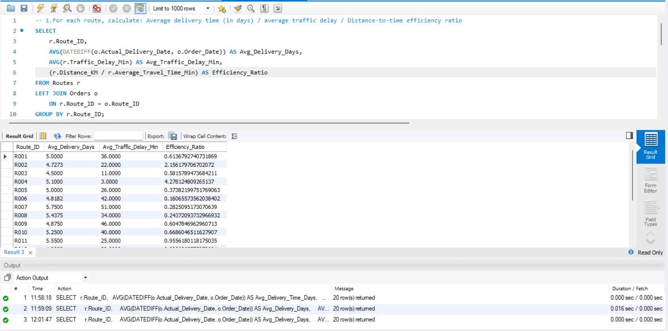
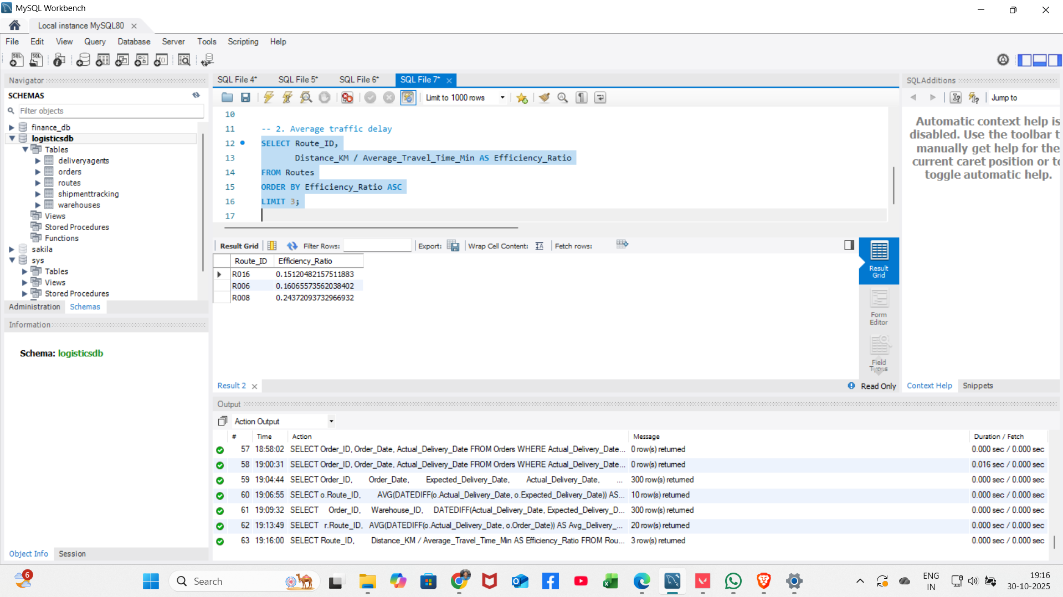
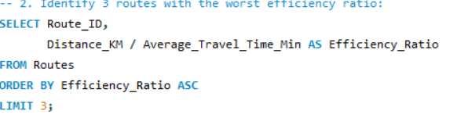
Task 3: Route Optimization Insights
Insights / How is this task performed:
1. Calculate avg delivery time, avg traffic delay, efficiency ratio
2. Identify 3 routes with worst efficiency ratio

Slide 8
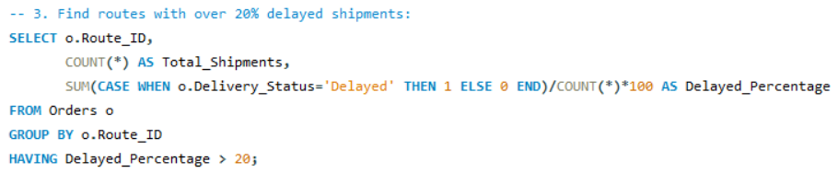
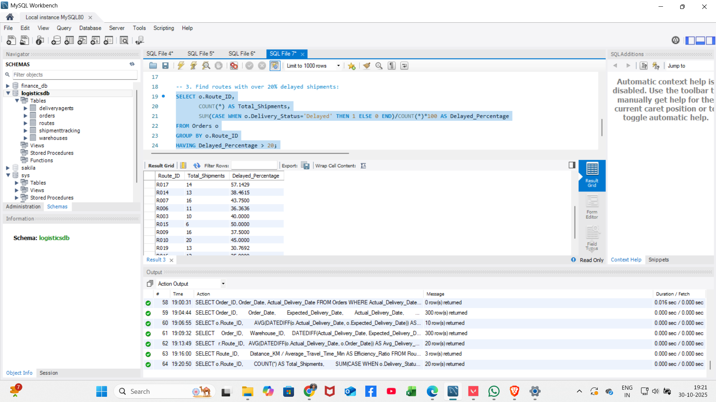
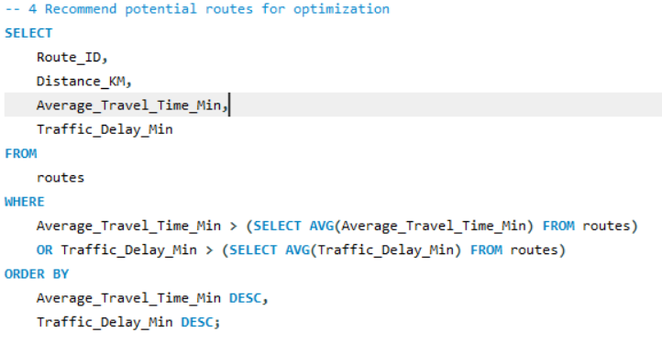
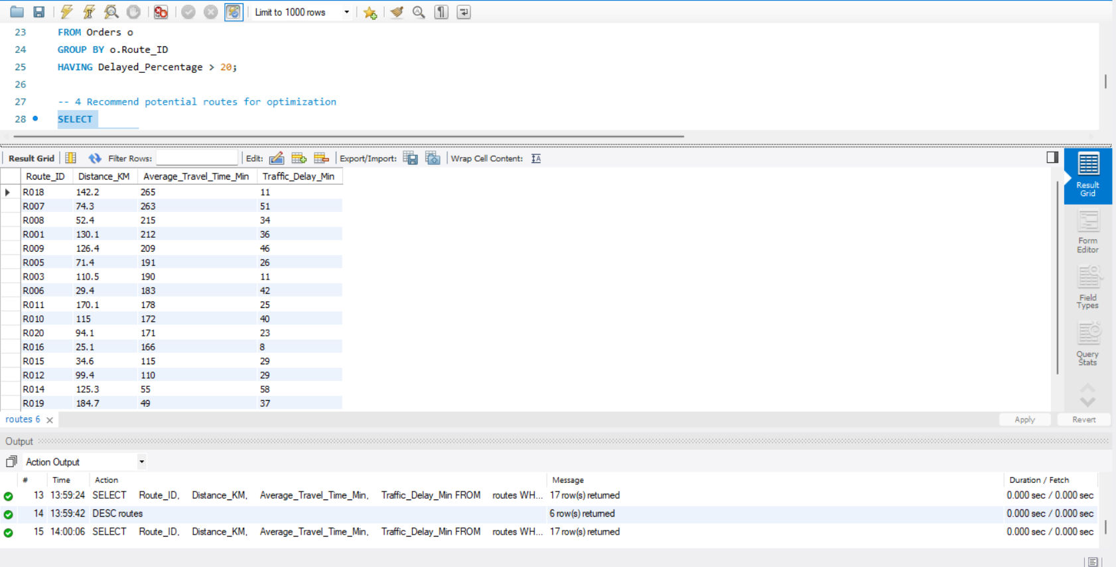
3. Find routes with >20% delayed shipments
4. Recommend potential routes for optimization
Recommendations:
Prioritize route optimization for those with high Traffic_Delay_Min and Average_Travel_Time_Min; these routes may benefit from revised schedules or alternate paths.​
Investigate recurring delay reasons from shipmenttracking to fix operational issues at specific checkpoints, reducing repeat delays

Slide 9
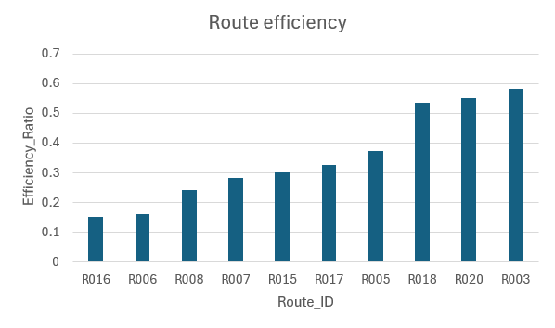
Insight: Routes R016, R006, and R008 are the least efficient and need improvement.
Recommendations: Focus on fixing these low-efficiency routes—try rerouting or checking for regular traffic

Slide 10
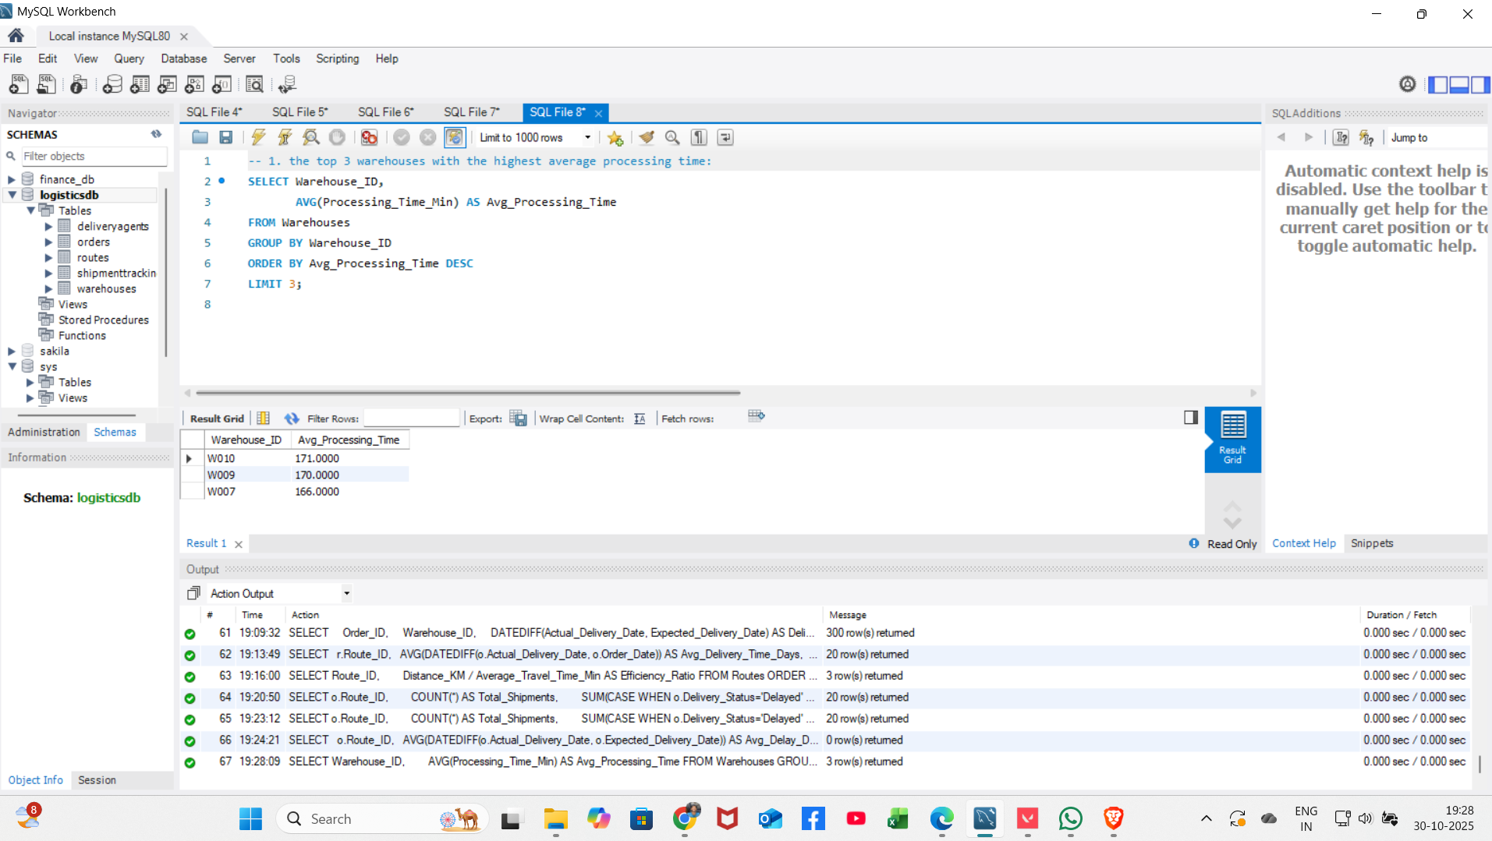
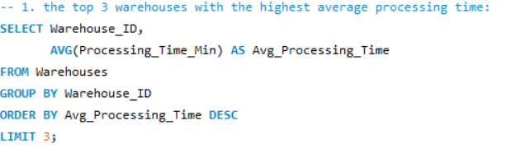
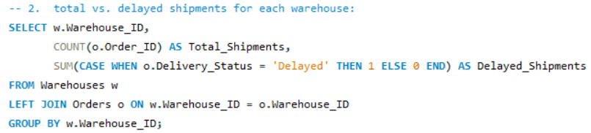
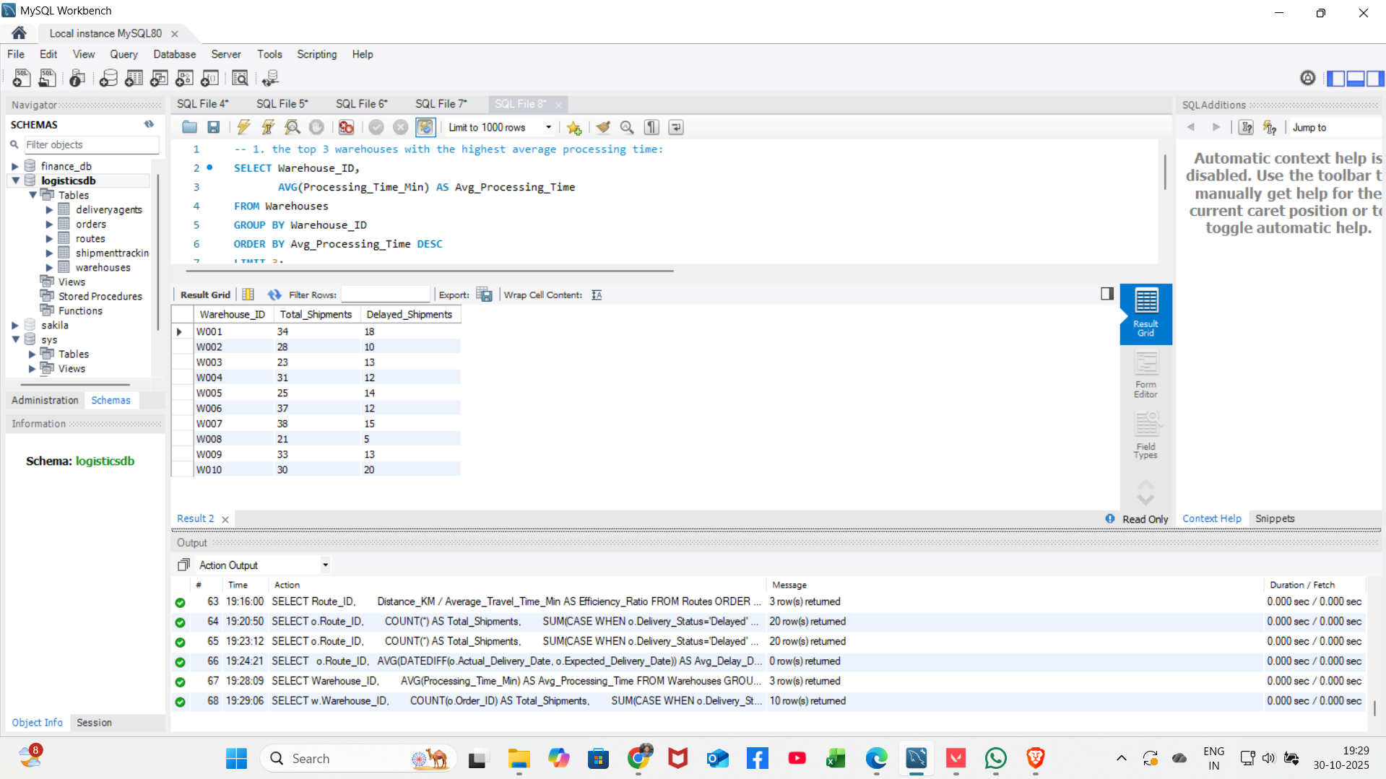
Task 4: Warehouse Performance
Insights / How is this task performed:
1. Find top 3 warehouses with highest avg processing time
2. Calculate total vs delayed shipments per warehouse

Slide 11
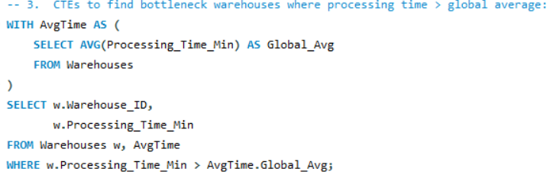
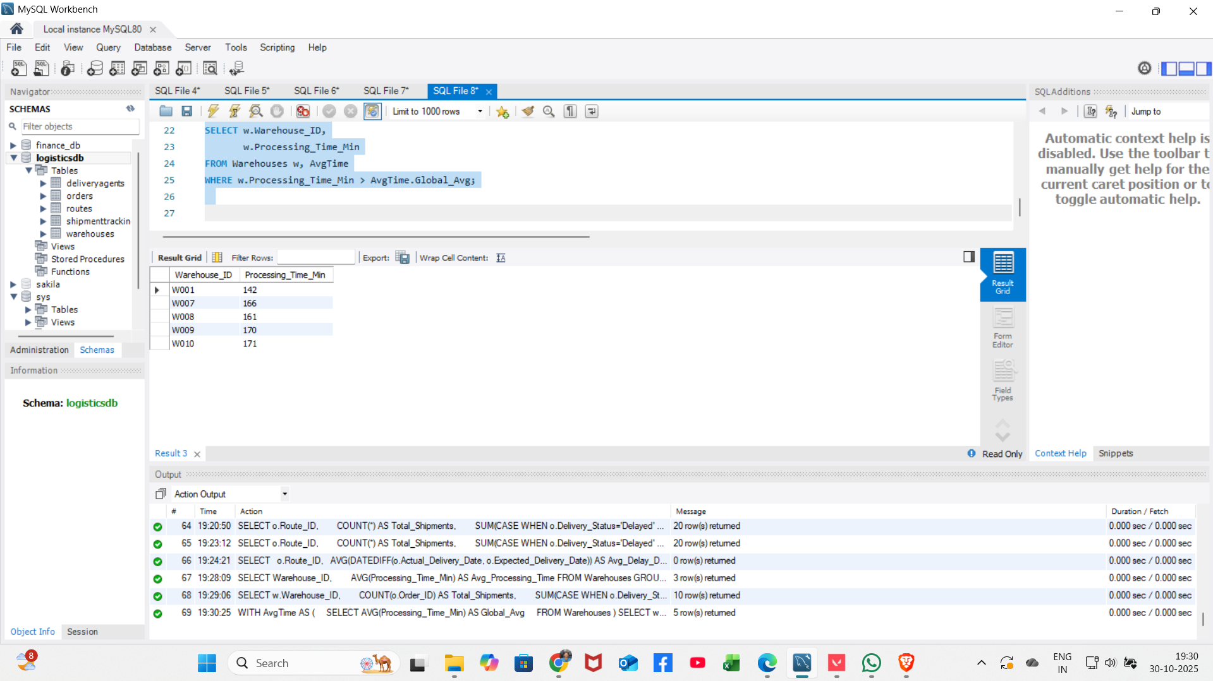
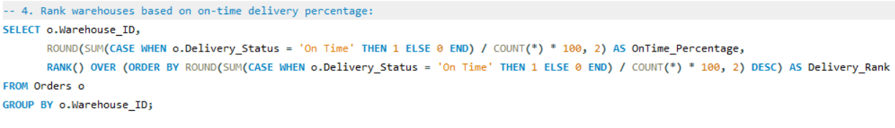
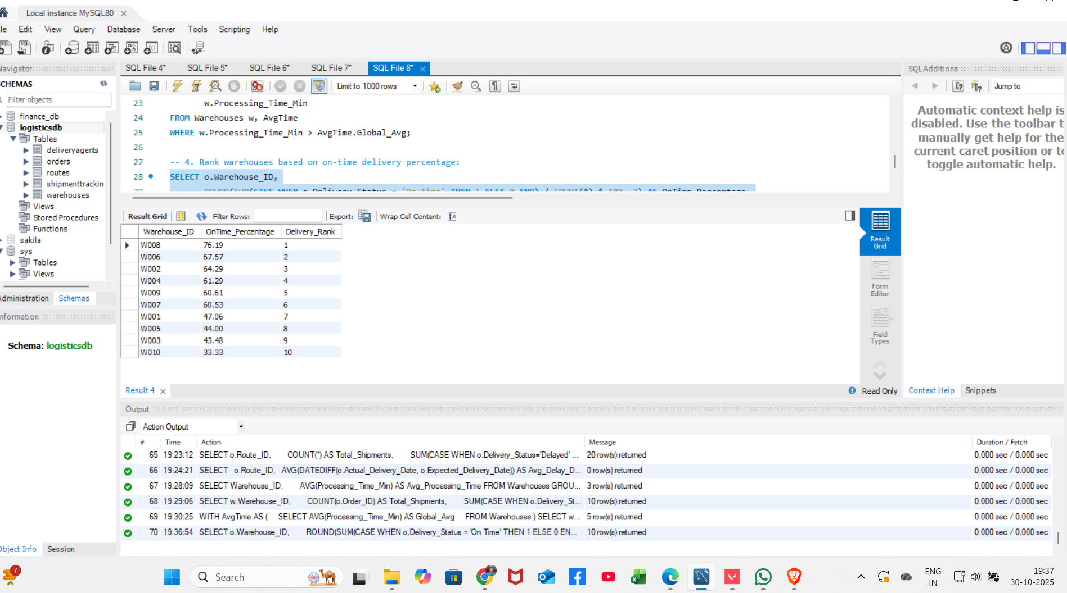
3. Use CTEs to find bottleneck warehouses (processing > global avg)
4. Rank warehouses based on on-time delivery percentage

Slide 12
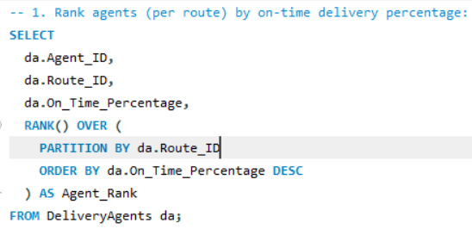
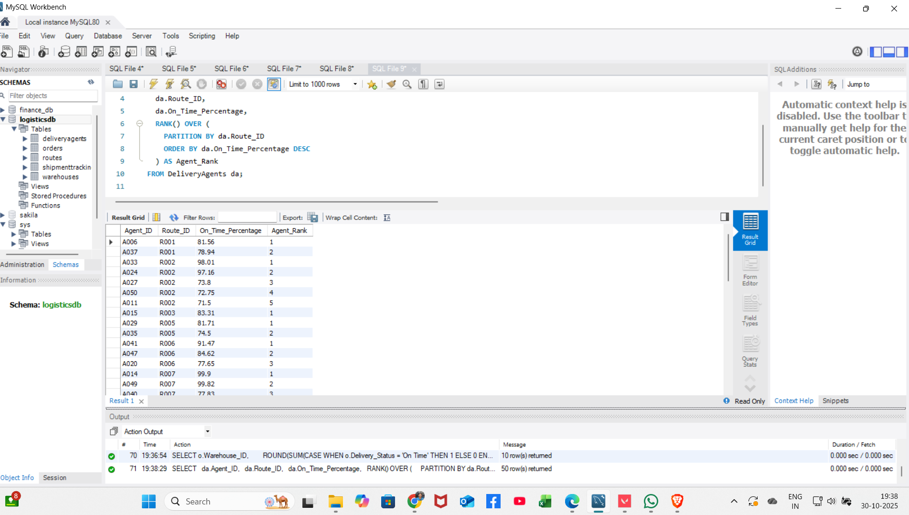
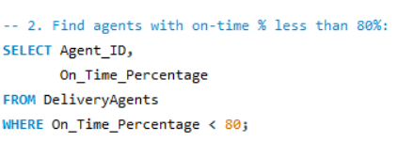
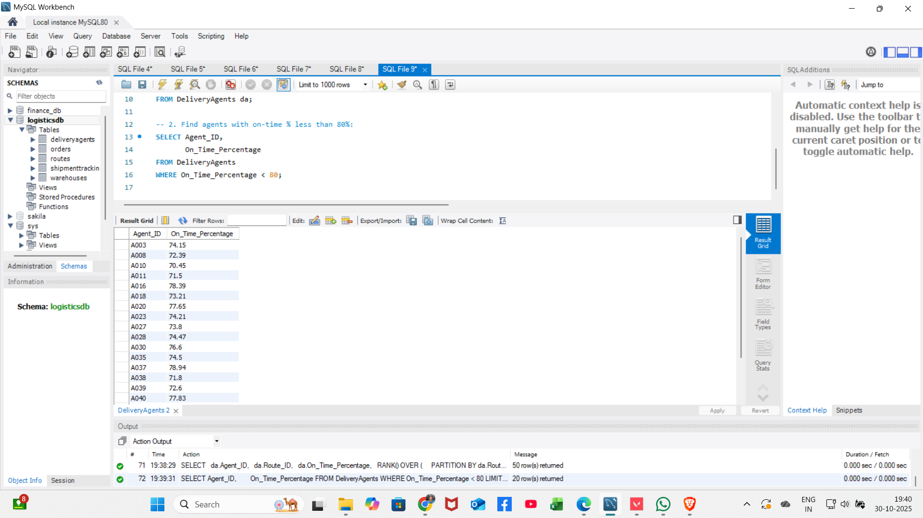
Task 5: Delivery Agent Performance
Insights / How is this task performed:
1. Rank agents per route by on-time delivery percentage
2. Find agents with on-time % < 80%

Slide 13
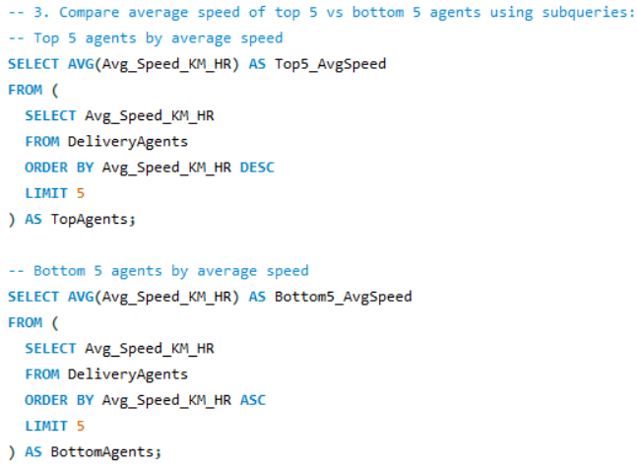
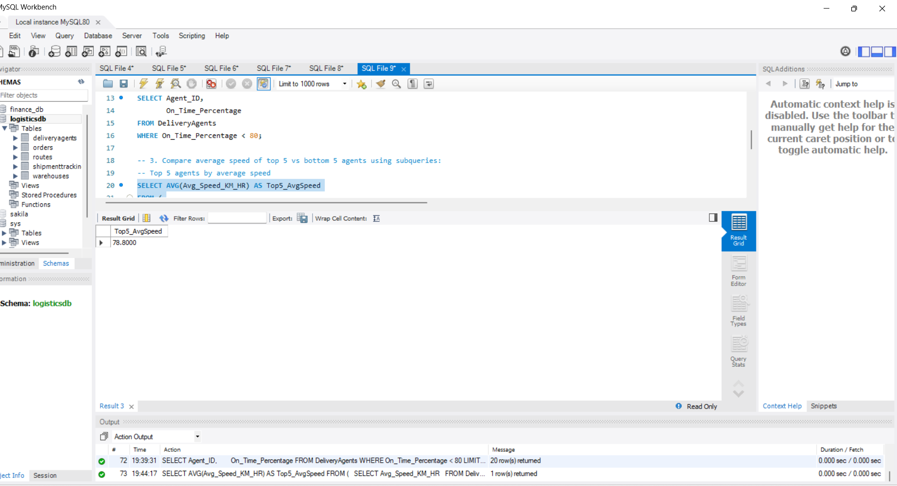
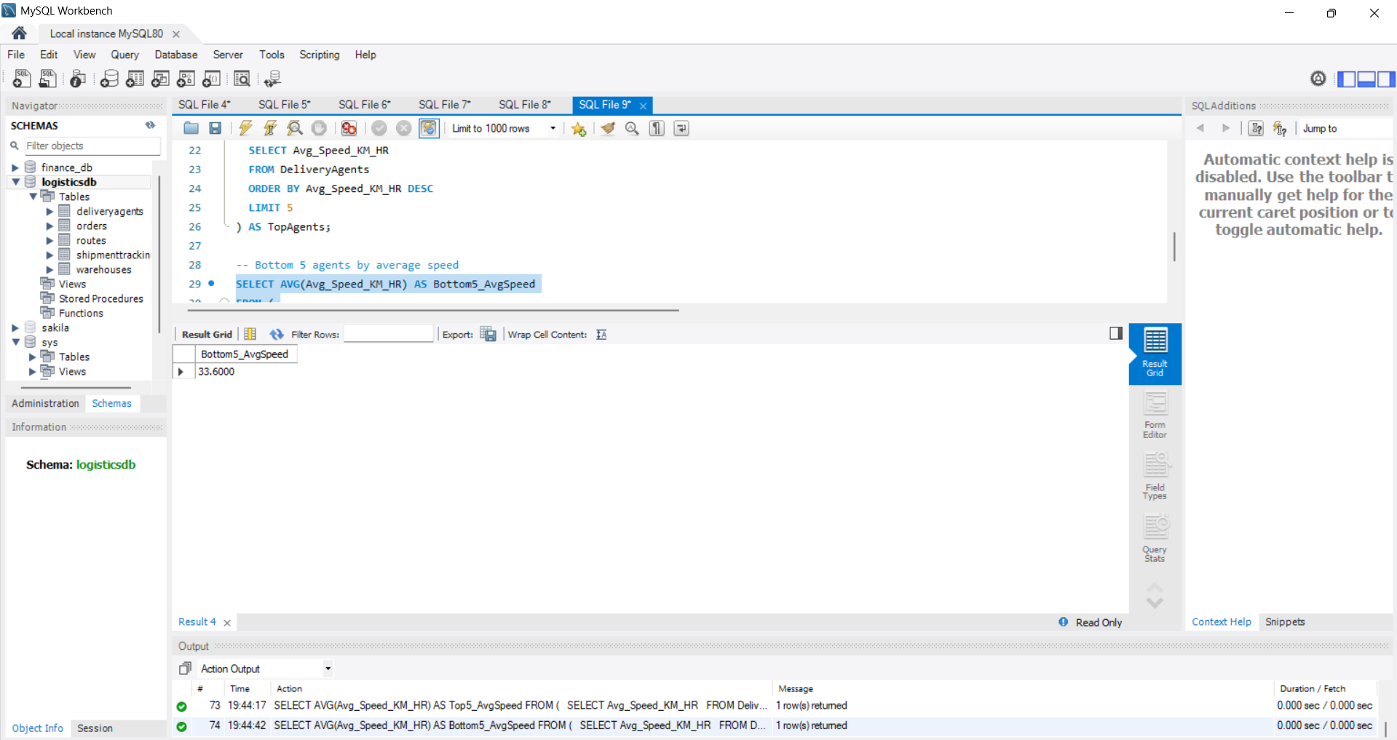
3. Compare avg speed of top 5 vs bottom 5 agents

Slide 14
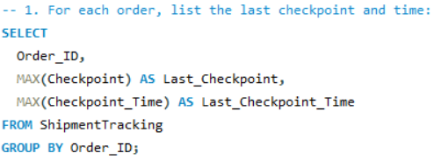
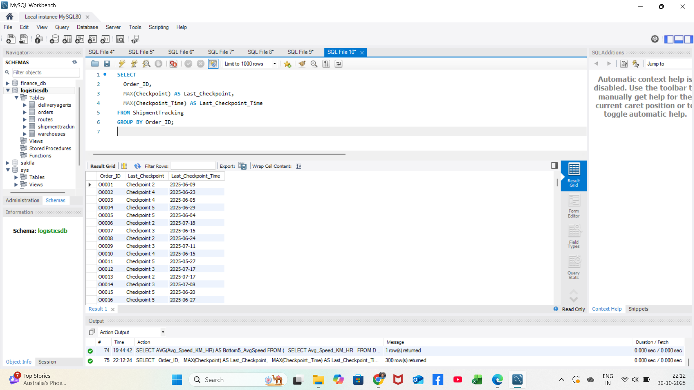
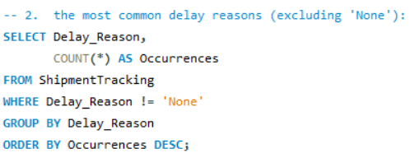
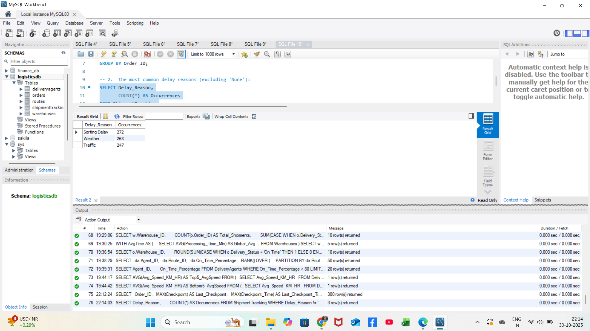
Task 6: Shipment Tracking Analytics
Insights / How is this task performed:
1. List last checkpoint and time for each order
2. Find most common delay reasons (excluding None)

Slide 15
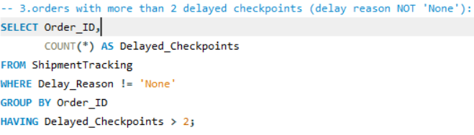
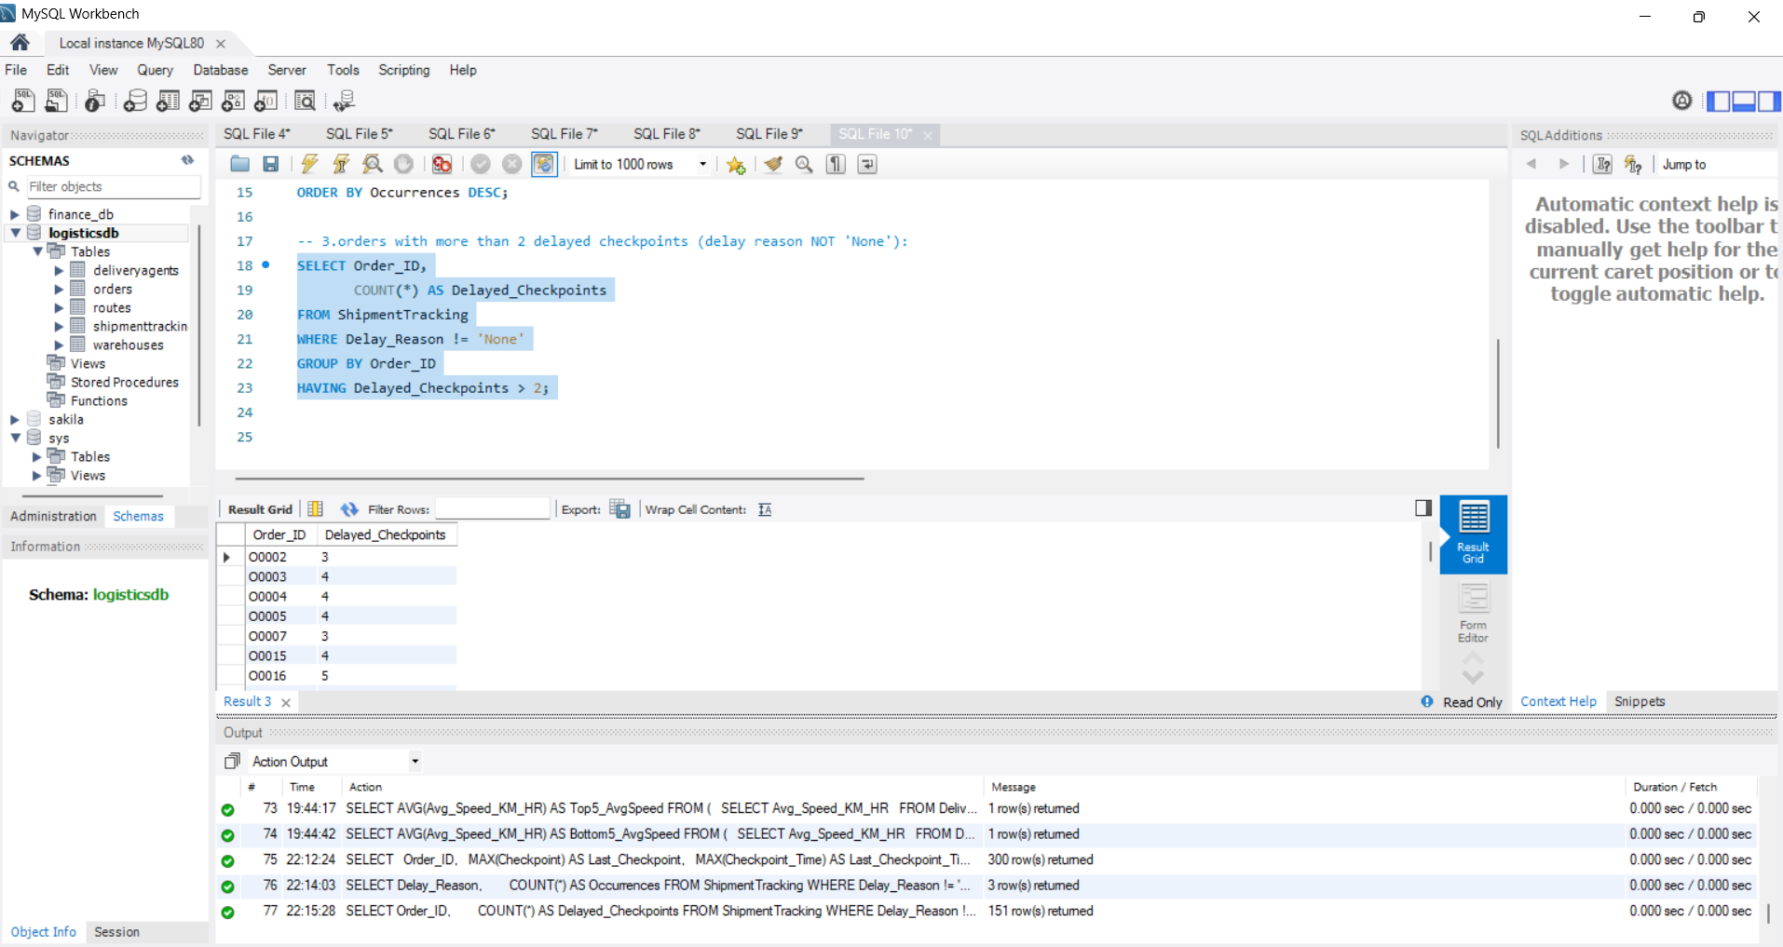
3. Identify orders with >2 delayed checkpoints

Slide 16
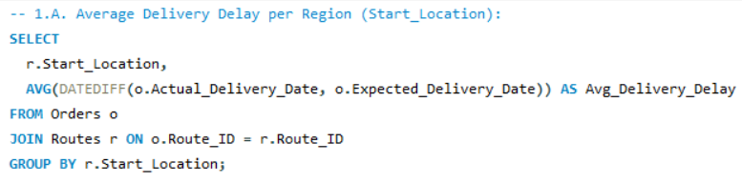
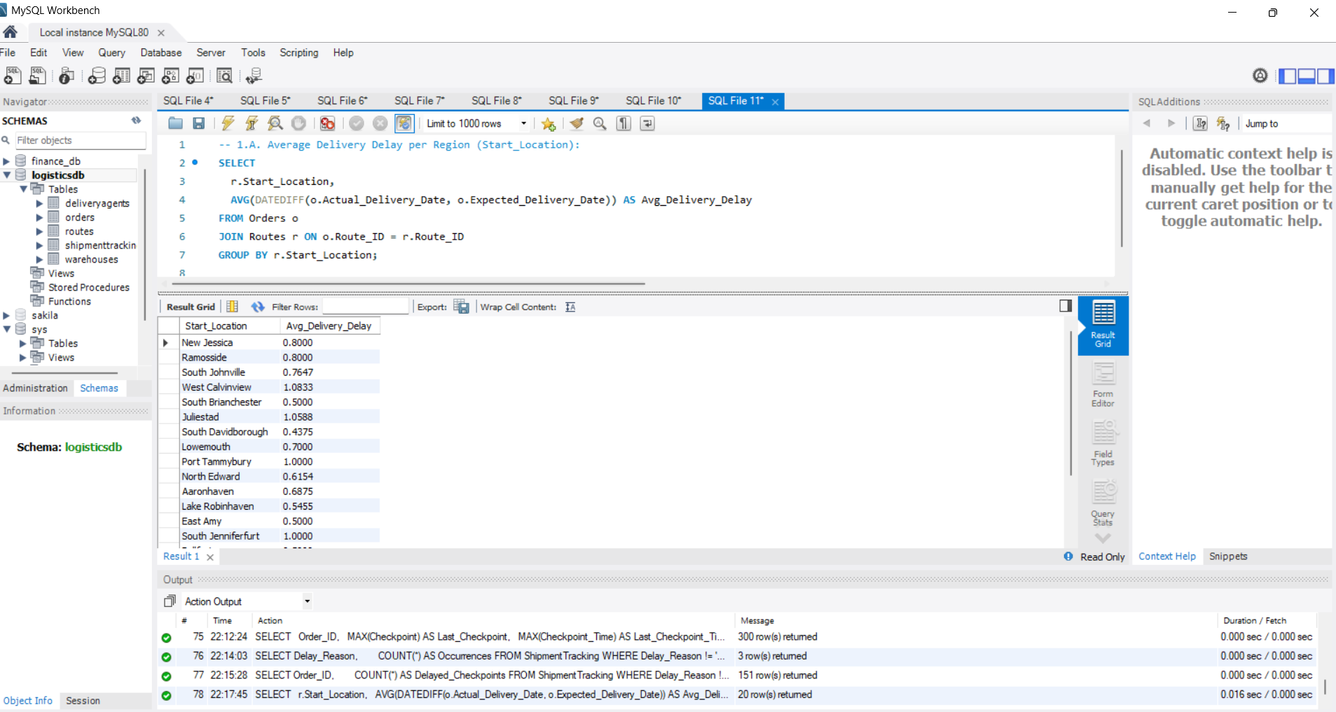


Task 7: Advanced KPI Reporting
Insights / How is this task performed:
1. Calculate avg delivery delay per region (Start_Location)
2. Compute On-Time Delivery %

Slide 17



3. Calculate avg traffic delay per route
Logistics KPI Dashboard
Recommendations:
Routes R014, R007, and R009 have the highest average traffic delays—these need urgent improvement.​
West Calvinview and South Johnville have the most delayed deliveries by region.​
Improve problem routes and regions, and review your on-time delivery percentage calculation for accurate tracking.

Slide 18
Presentation video link :- https://drive.google.com/file/d/16k_GEQGha2Eb3Y8gG7bJX76pYyImLtVL/view?usp=sharing

